Slide 2
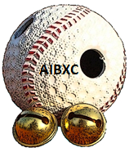
BATBALL

Slide 3
Italie
Championnat à 9 équipes

Slide 4
FRANCE
Nogent Sur Marne Pau Montpellier

Slide 5
Allemagne

Slide 6
Project Objectives
Cooperation between volunteers and universities to develop international means of communication
Train future professionals able to understand the various disability policies in Europe.
Promote international meetings.

Slide 7
Results expected
Design educational case in 4 languages:
Video documents: training exercises, game phases, routine and arbitration mechanics game notebooks (players, coaches, referees, scorers),
International tournaments
Adaptation of the material to a synthetic playing surface

Slide 8
impact expected
Increase in the number of practitioners
Training of Blind baseball teaching specialists at European level.

